Slide 1

Trade Bot Advisor
Contributors:
Alpa Sheladia, Brian Withrow, Mischelle Massey, and Nathan Kleiner, Lee Redfearn
Notes:
In this project, we as a team set out to define how certain variables possibly affect stock price positively or negatively focusing on the time period of the pandemic. Certain sentiment factors placed on media articles were identified using financial dictionaries and context was used to determine possible volatility in addition to other features such as Beta, VIX, Closing Price and Volume. After identifying these factors and scores, new class frames were created to run consecutively with created models to produce a result as accurate as possible with the help of a bot. Companies that we used for our research were Exxon (XOM) , American Airlines (AAL) , Zoom (ZM) , Apple (AAPL) , Bitcoin (BTC) , and Pfizer (PFE).

Slide 2
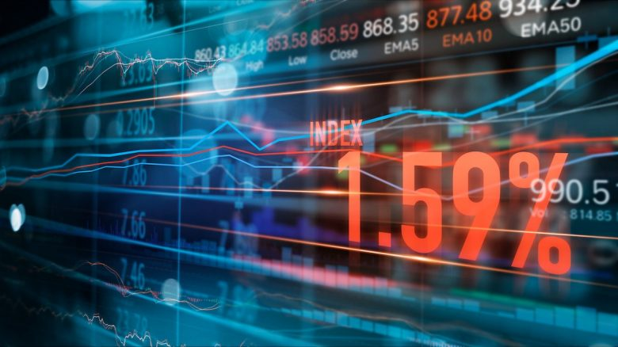
What is Trade Bot Advisor?
An AI that investigates several variables within the financial data market pertaining to an open market that emphasizes association between stock price and media sentiment. Afterwhich the bot makes predictions from past data to determine stock prices for the following day.
Trade Bot Advisor was motivated by the need to understand within financial news articles if sentiment affects the overall market and the stocks reported.
Notes:
A Trade Bot Advisor is an interactive tool used to communicate with an End User to compile, quickly analyze, and determine the best approach a User should take when deciding which particular stock is better than another. This Bot uses data from its features (VIX, Sentiment scores)and makes the best hypothesis using the input of past and current data to make a trading model.

Slide 3
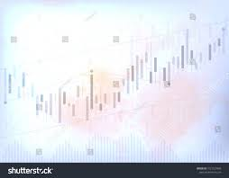
Data Source
Trade Bot Advisor utilizes customized class(Stockscrub) to gather data from the following features and their sources to make its predictions:
Sentiment Scores (GoogleNews API, Newspaper3k API, LM dictionary)
VIX indicator (Quandl API )
Stock price (AlphaVantage API)
Volume (AlphaVantage API)
S&P500 Beta Indicator (Yahoo finance API)
Notes:
THis bot utilizes various features through the use of customized class to gather information (StockScrub) focusing on sentiment scores than also analyizing the VIX indicator, stock price, Volume and the betta indicator

Slide 4
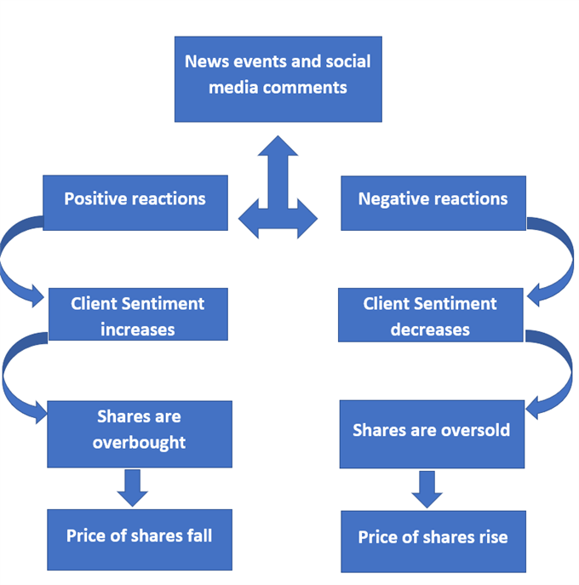
Notes:
This image shows how sentiment analysis is normally used in analyzing stocks and how positive and negative context can have and the influence certain information can have on an acquisition.

Slide 5

Cleaning Data
We used multiple APIs such as Yahoo FinanceAPI, Google News API , Quandl API, and Alphadvantage API to pull necessary data. Thereafter, duplicate were removed using links (as links are unique identifiers).
In order to achieve the desired historical data from the S&P 500, we used a Yahoo Finance API to extract specific relevant data.
A unique class(StockScrub) was created to import, organize, and clean the data to organize into a dataframe using a customized function get_compile() to combine all data retrieved from the APIs.
Finally, in order to compute sentiment scores we used Newspaper3k API to extract required content from the article links provided by Google API which was rather difficult using get.sentiment() function of the Stockscrub class. . Manual tokenization was required to produce articles without NLTK using regular expressions. LM Dictionary was used to clean various sentiment using specific financial stopwords.
Notes:
Efforts were exhausted in the retrieval process of information from several APIs due to policy indifferences.
It was difficult to find extensive history of S&P 500 and if we found it it was stored under various names. For instance: on Quandl S&P500 is called INX, verses on yahoo finance it’s called GSPC.
Because google API includes only the links of the article, we incorporated newspaper API into the get.sentiment() function of the stockscrub class.

Slide 6
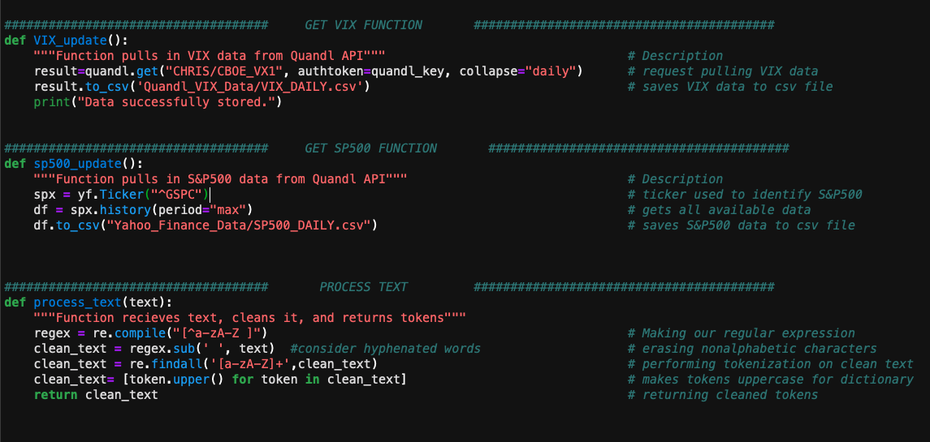
Code to Clean Data
Notes:
These are functions that we used in our main files. It fetches the vix data from quandl, fetches S&P 500 data from Yahoo Finance while manually tokenizing it. Lastly process_text premanalary cleans the data while removing words that aren’t alphabetical while splitting up the words.

Slide 7
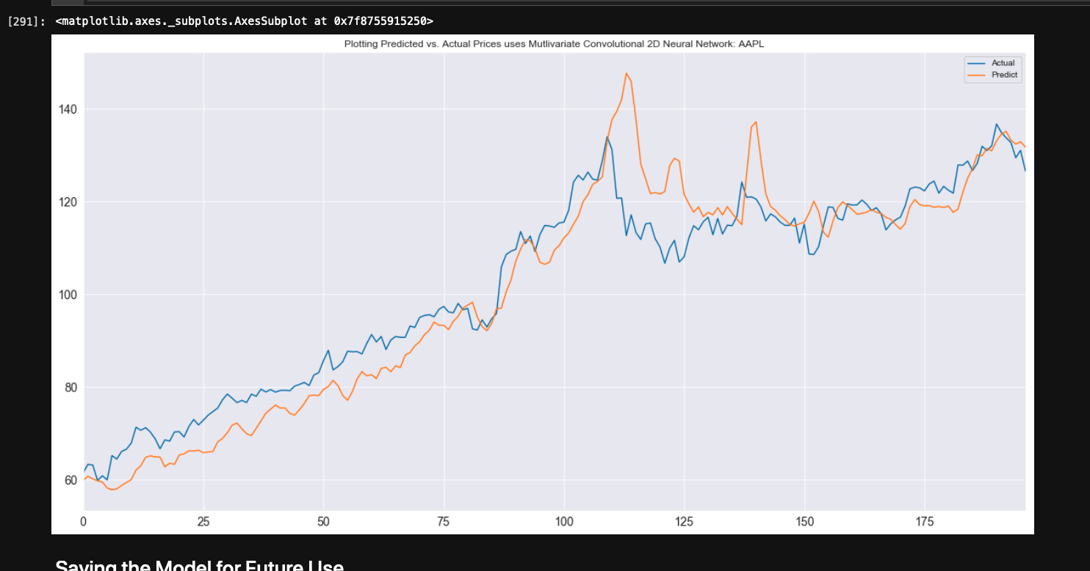
Apple’s dataframe

Slide 8

Sentiment Analysis
Terms in finance can vary in meaning depending on the context:
- We used the LM Dictionary to provide a refined sentiment score since standard methods prove to be inefficient.
Ex: “decrease” in dividends or “decrease” in overall expenses
Notes:
Sentiment Analysis is a method of using natural language processing to identify, extract, quantify, and study subjective information. In this project we used sentiment analysis in a financial sense to identify the context of financial articles which may have an positive or adverse effect on stock price. Identifying the context of a financial article in comparison to a generalized article can produce varying results as the words used could be similar within the two but have two totally different meanings which therefore affects a stock’s performance ultimately altering a User’s decision to buy, sell, or hold. We gathered information from various Google News API’s, cleaned the data, and then ran the data through a LM Dictionary(Loughran-McDonald) which was specifically designed for financial sentiment analysis. This dictionary provided another cleaning of the data removing any STOP words from an extensive list that separated words defined as positive, negative, uncertain, and model, weak, and so-on. All the cleaning refined the analysis to aid in producing a more accurate score at the end of the model.

Slide 9

Sentiment Analysis Cont.
The Newspaper3k API was utilized to extract articles from links generated from GoogleNews API
LM used to compute various sentiment proportions (positive, negative, uncertainty,etc.)
Tokenization of articles was executed manually without nltk using regular expressions
Results were compiled into a DataFrame object and stored for further use

Slide 10
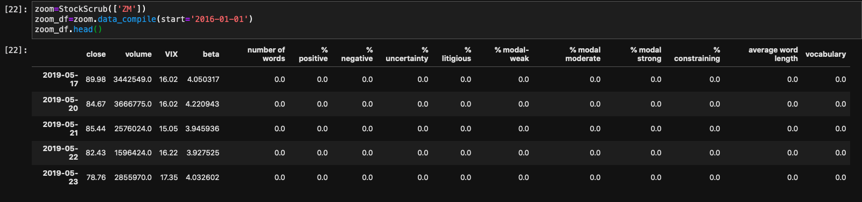

Slide 11
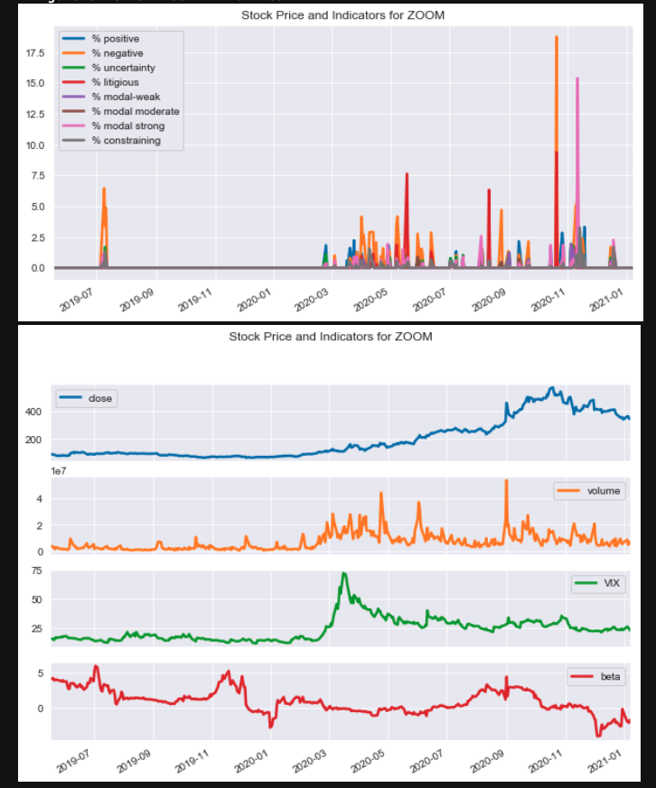
Actual Sentiment scores for ZOOM

Slide 12

Convolutional Neural Networks
All techniques all models from class only made use of univariate data (previous prices of asset)
All techniques all models from class only made use of univariate data (previous prices of asset)
In deep learning, a convolutional neural network is a class of deep neural networks, most commonly applied to analyzing visual imagery. We repurposed the network to a multivariate signal to get readable results in order to incorporate the information from all features and identify the feature that was significant to predict the price for next day.
Since our data is multivariate, it is analogous to a multivariate signal.
Notes:
In deep learning, a convolutional neural network is a class of deep neural networks, most commonly applied to analyzing visual imagery. They are also known as shift invariant or space invariant artificial neural networks, based on their shared-weights architecture and translation invariance characteristics. We repurposed it to multivarious signal to get readable result in order to incorporate the information from all features and identifies the feature significant to predict the price for next day.
Loughran-McDonald Master Dictionary to compute sentiments scores. The dictionary was design for the usage of specific stop words when creating financial models.
EX: correlation is used for object/feature detection and recognition. But, the input image(being our data) should be pre-processed

Slide 13
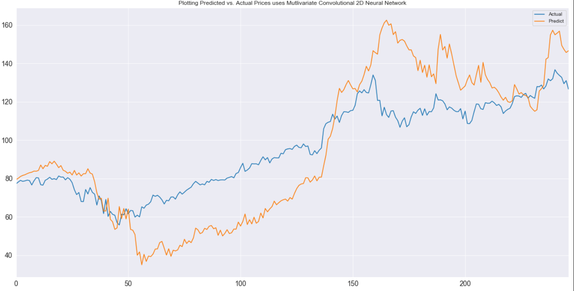
Notes:
the Conv2D Neural Networking. These are results for Apple without including sentiment. GoogleNews API is deprecated, so I had to make additional modifications for its intricacies.

Slide 14

Machine Learning
We trained CNN 2D model to fit all the assets

Slide 15
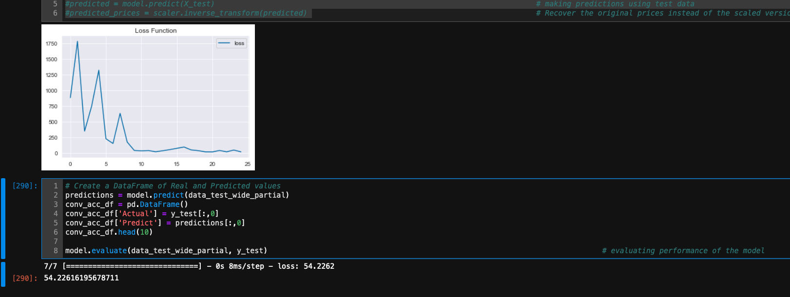

Slide 16
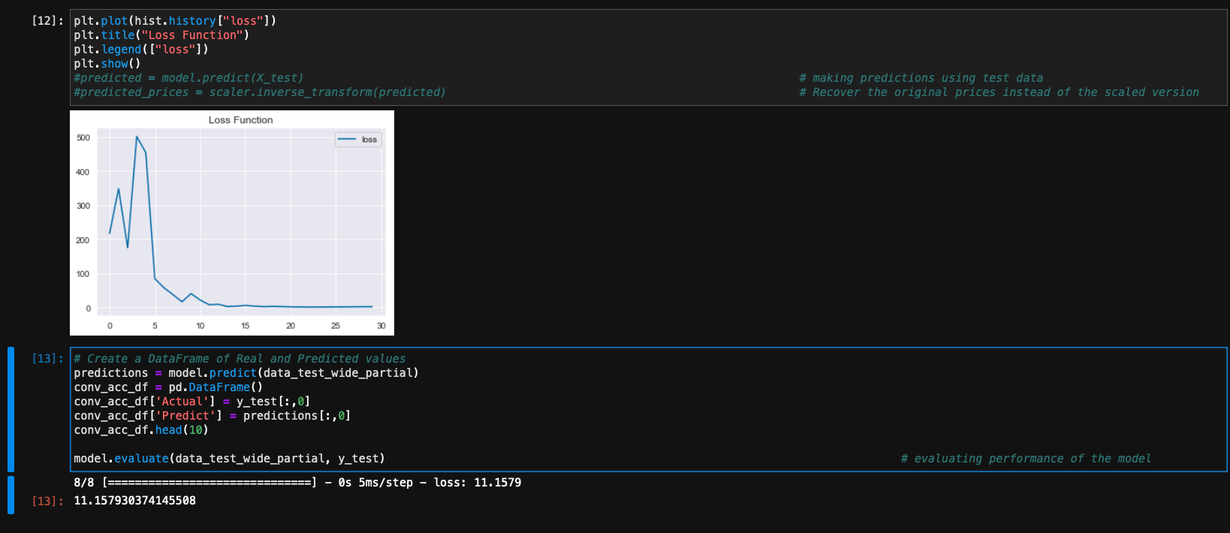

Slide 17
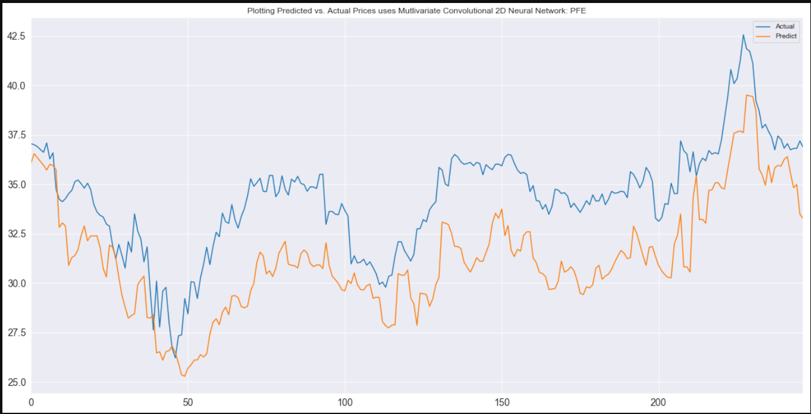

Slide 20
Final Results
What information or problem was resolved for the User?
User will see reliable accurate information regarding the acquisition of stock and use the data to determine whether a User should buy, sell, or hold.
How much does the media sentiment influence the price of stocks?
Extreme events led to biased and unbiased media coverage which affected stock prices based on the financial sentiment analysis.
How accurate were the predictions?
With sentiment feature, mean test error rate of Apple’s was 74.92, Pfizer;s was 20.43, American Airline’s was 530.42, Exxon’s was 565.90 and Zoom’s was 44518.51
What event occurred in the media caused these signals.
During the time period that was discussed the main event that occurred causing shifts in the data was COVID-19 pandemic

Slide 21

Our Discovery
What are your findings of the news media's contribution in the stock market volatility over past three-four years?
We used several features and academic research to figure out that media plays crucial role in market volatility. We redefine sentiment and multivariate to extract data from news articles to see the affect on future prices of stocks.
Is this a supervised or unsupervised learning task? what are data features and what is the target variable?
This is supervised learning task since the data is provided with target variable is next day's price . Data features include parameters, prices,VIX, Sentiment, Closing Price and Volume.
● How did the Machine learning play a role in it?
In deep learning, a convolutional neural network is a class of deep neural networks, most commonly applied to analyzing visual imagery. They are also known as shift invariant or space invariant artificial neural networks, based on their shared-weights architecture and translation invariance characteristics. We repurposed it to multivarious signal to get readable result in order to incorporate the information from all features and identifies the features significant to predict the price for the next day.
Which specific stock most affected by news media?
Zoom was doing well during Covid-19 events till On Aug. 20th 2020. Zoom crashed tremendously .
Notes:
what are your findings of the news media's contribution in the stock market volatility over past three-four years?
We used several features and academic research to figure out that media plays crucial role in market volatility. We redefine sentiments and multivariates to extract data from news articles to see the affect on future prices of stocks.
● Is this a supervised or unsupervised learning task? what are data features and what is the target variable? If unsupervised, what are the data features and what do we hope to find?
This is a supervised learning task since the data is provided with target variable is next day's price . Data features include parameters, prices,VIX, Sentiment, Closing Price and Volume.
● How did the Machine learning played role in it?
In deep learning, a convolutional neural network is a class of deep neural networks, most commonly applied to analyzing visual imagery. They are also known as shift invariant or space invariant artificial neural networks, based on their shared-weights architecture and translation invariance characteristics. We repurposed it to multivarious signal to get readable result in order to incorporate the information from all features and identifies the feature significant to predict the price for next day.
which specific stock most affected by news media by what event?
According to Forbes, Zoom was doing well during the Covid-19 events until August 2020 because of a potential vaccine, if effective and if widely distributed, implies that Zoom’s growth and user base could slow. If more people return to in-person work or if social distancing rules are eased, or both, fewer people could use Zoom. While a 20% stock price drop is relatively small against the backdrop of year-to-date performance, it could be a sign of further downward pressure on Zoom’s share price if the vaccine receives regulatory and marketing approval.
Zoom was doing well during Covid-19 events till On Oct. 20th 2020 Zoom crashed tremendously .

Slide 22

Cherished Moments
Notes:
We began the project with an exciting idea to have an animated AI personnel (and we named it the Trader Bot Advisor) to provide stock advice (such as buy or sell options) to the user. We launched a thorough search for a program that would meet our expectations and needs for the project. But to no avail, out attempts were unsuccessful due to time constraint and incompatible programs.
The Trader Bot Advisor became real to us especially after discovering botlibre.com and realizing the possibilities of creating one for the project. However, the idea became just that ...an idea because the migration process was not compatible with jupyter notebook application. And to add to that disappointment, the AWS bot service could not handle all the data. There was just simply too many errors.

Slide 23

Questions and Discussion

